Slide 1
Digital Library
Formative Assessment Practices

Slide 2
Overview
Formative Assessment Process
Smarter Balance Digital Library Overview
Smarter Balance Digital Library Tour

Slide 3
Definition of the Formative Assessment Process
Formative assessment is a deliberate process used by teachers and students during instruction that provides actionable feedback that is used to adjust ongoing teaching and learning strategies to improve students’ attainment of curricular learning targets/goals.
It is also called “assessment for learning.”
Notes:
There is a misconception that formative assessment is simply handing out a test periodically throughout an instructional unit. Teachers need to familiarize themselves with the many types of formative assessment that can be utilized to inform instruction and reteaching.

Slide 4
Four Attributes of the Formative Assessment Process
Clarify intended learning
Elicit evidence
Interpret evidence
Act on evidence
Notes:
Clarify intended learning → objective/learning goal
Elicit evidence → what students need to produce/demonstrate
Interpret evidence → what can be determined from the evidence a student produces
Act on evidence → how the evidence guides instruction from this point

Slide 5
Digital Library Resources
Sources:
  State Network of Educators (SNE) developed
  Commissioned modules
Types:
  Instructional
  Professional Learning
  Combination
Notes:
Instructional: Lesson Plans, Videos
Professional Learning: Model Lessons, Strategies

Slide 6
Criteria for Resources
Aligns with CCSS
Incorporates formative assessment practices
Demonstrates high-quality instruction
Addresses learner differences
Is engaging and user-friendly
Notes:
Several criterion had to be met in order for a resource to even be considered for the digital library. If it did meet all the criterion, it then had to be approved by multiple people before being added to the site.

Slide 7
The Digital Library is Not…
A bank of assessment items
A learning management system in which educators can register for training or receive credit by completing specific online courses
A library for general public (will require registration and login)
A site to freely post resources
Notes:
A lot of assumptions about what the digital library is are incorrect. Here are some examples of what it is NOT intended for.
(not designed as a lesson plan creator, not a sub plan)

Slide 8
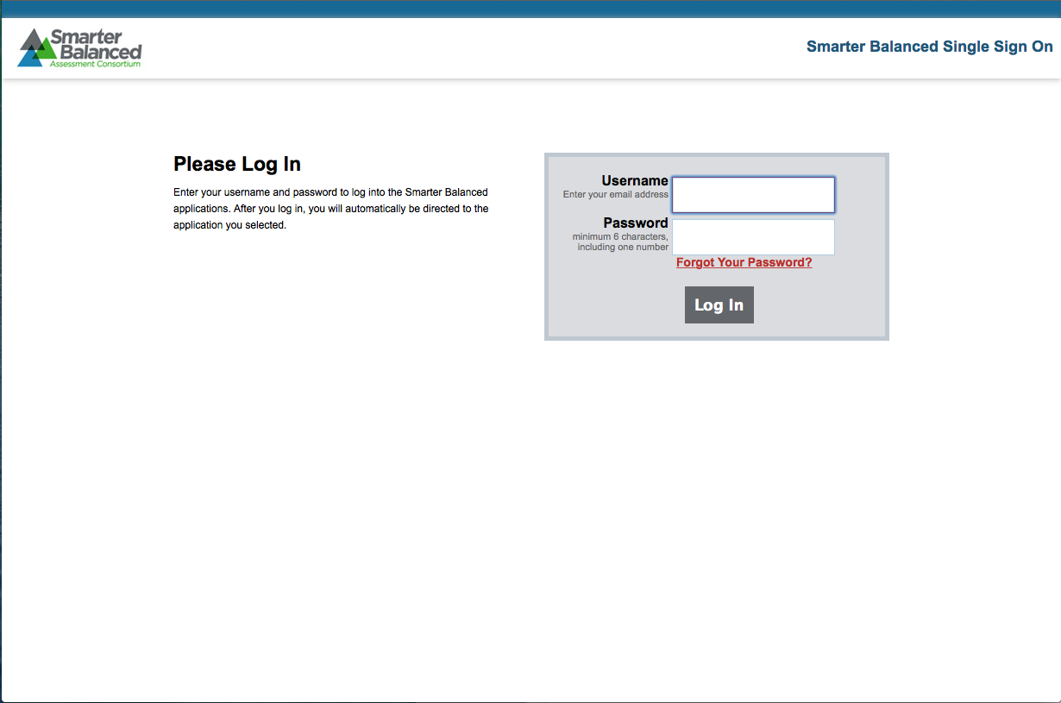
Tour of the Digital Library:
Digital Library Log-in Page
Notes:
smarterbalancedlibrary.org

Slide 9
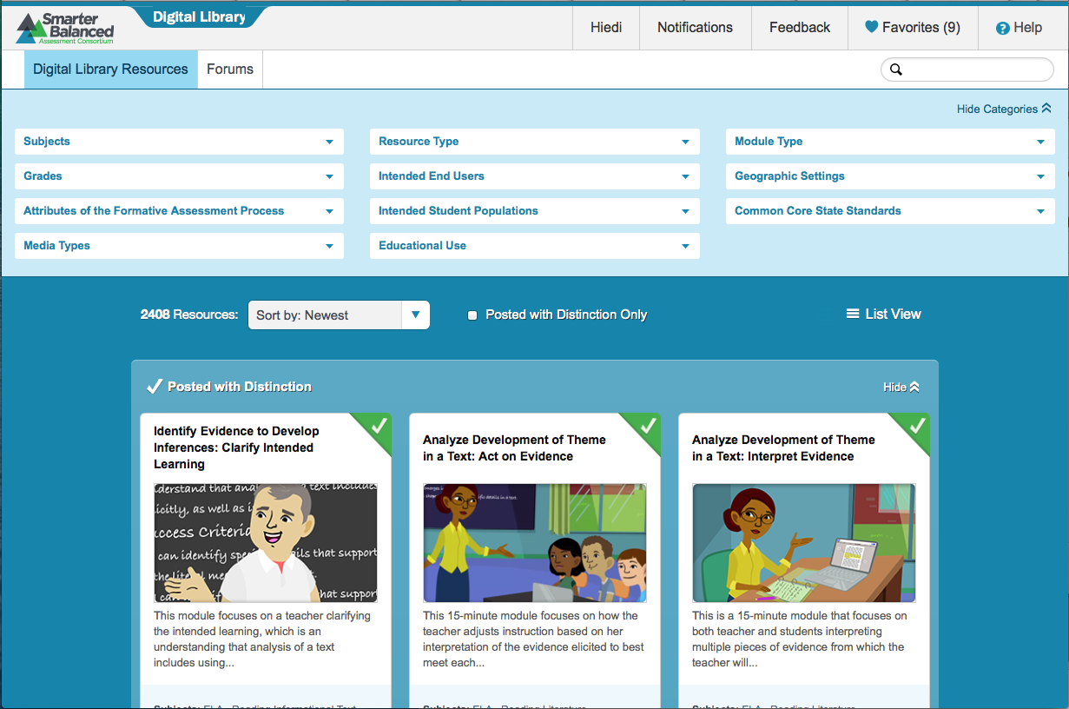
Tour of the Digital Library:
Digital Library Front Page
Notes:
This is the first screen you will see after logging in.

Slide 10
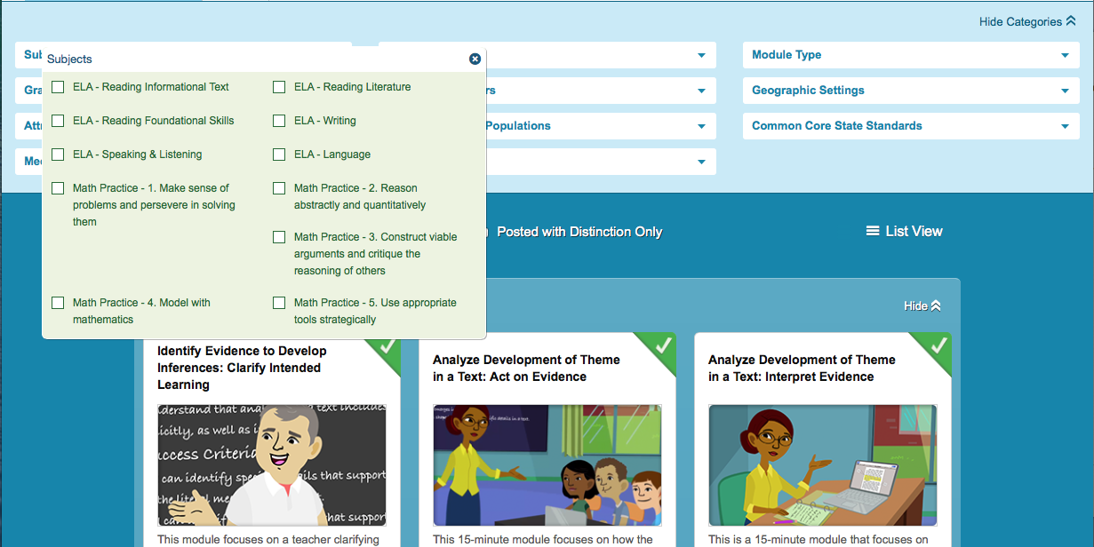
Tour of the Digital Library:
Filter Example
Notes:
Multiple filters can be applied to narrow down search results. Using too many filters might restrict the search results too much. 2 to 3 filters are recommended.

Slide 11
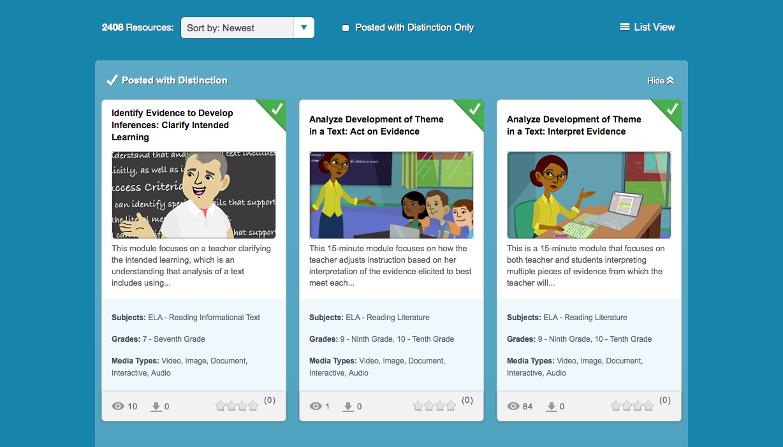
Tour of the Digital Library:
Resource Card Example
Notes:
This is how the search results will appear when the filters are applied.

Slide 12
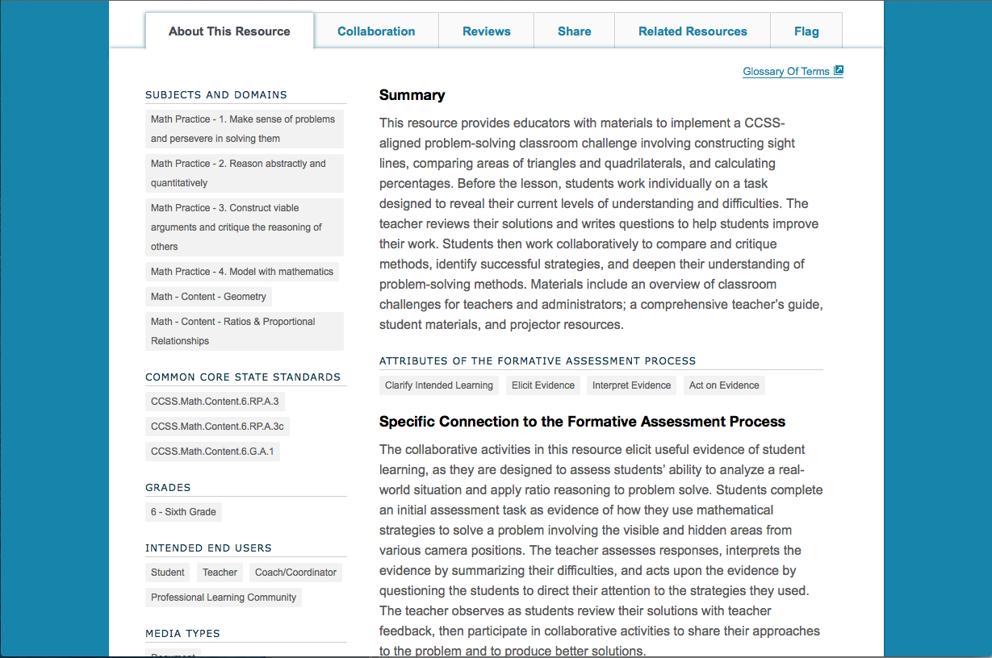
Tour of the Digital Library:
Resource Page
Notes:
After clicking on a particular resource, a summary will be displayed. This summary will help teachers determine if it is an appropriate resource for their purpose.

Slide 13
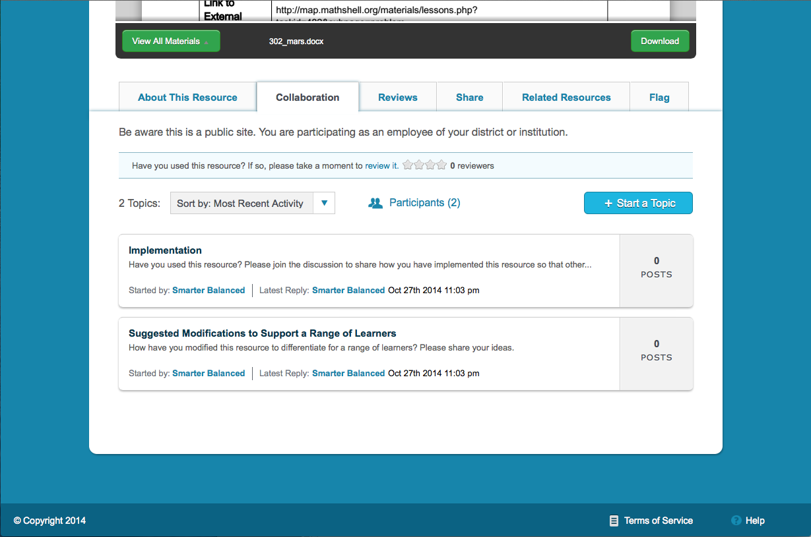
Tour of the Digital Library:
Collaboration Page
Notes:
The collaboration page gives educators the ability to ask questions or share information regarding a particular resource.

Slide 14
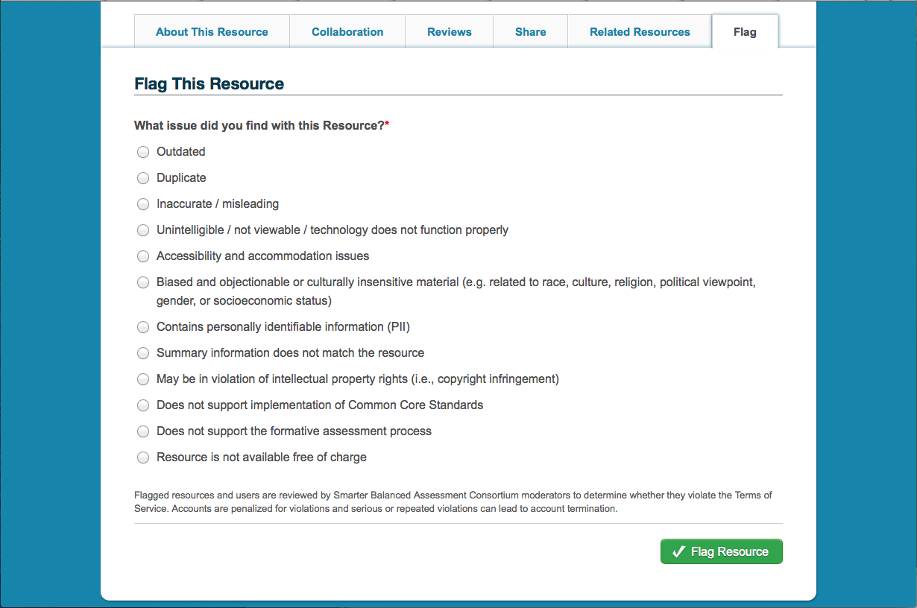
Tour of the Digital Library:
Flag Page
Notes:
If an educator finds a resource they feel is inadequate or inappropriate for the site, they are encouraged to flag the resource so it can be reviewed again.

Slide 15
To access the Digital Library:
You should have received an e-mail from Smarter Balanced that provided you with a temporary password
Go to smarterbalancedlibrary.org
Login in with your temporary password and reset your password
Once logged in, provide the introductory information requested
Take time to explore the resources offered through the Digital Library

